Slide 1
Digital system Design flow

Slide 2
Index
Abstraction of computer architecture
Basic components of digital system
Partition of digital system Datapath and Controlpath
ASMD chart
Example of mapping from algorithm to digital system

Slide 3
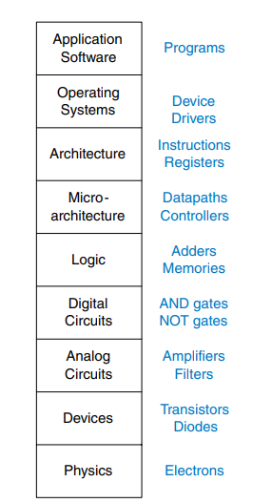
Abstraction of computer architecture

Slide 4
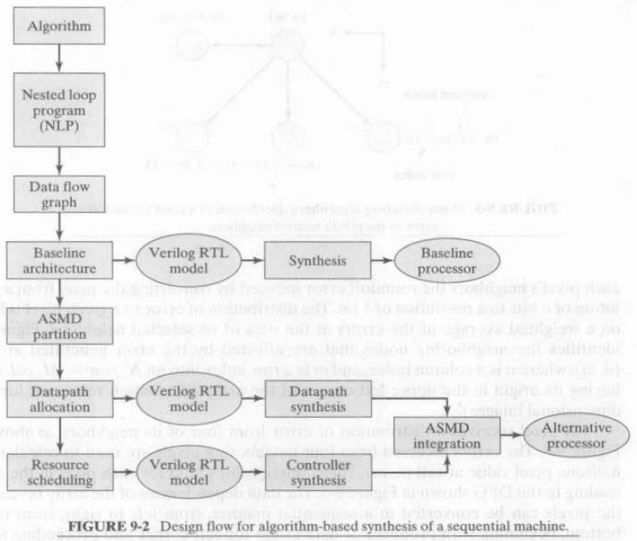
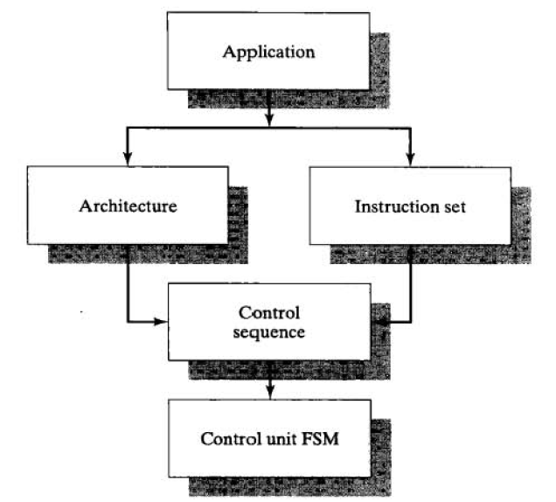
My Basic Flow

Slide 5
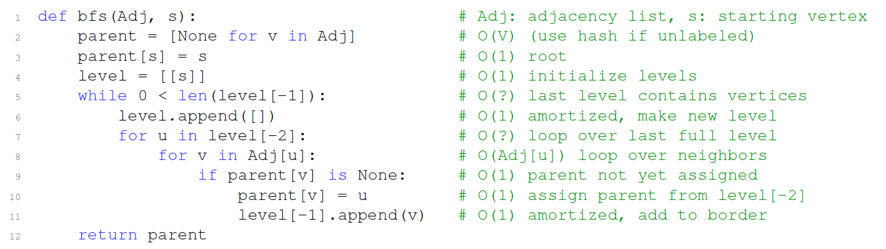
Algorithm for functional Verification and Performance Analysis

Slide 6
Why do functional verification in algorithmic level?
It is easier to debug using high-level language like C or Python
You can easily discuss or share your algorithm with others
Analysis and optimization techniques for algorithm design can be used
Corner cases can first be detected before you map your Algorithm to HW
Can do quick analysis about the final performance of your digital circuit
Separate algorithmic errors and RTL implementation errors

Slide 7
My inspection and Experience
Try to pick or derive an algorithm in iterative form which exist as many loops as possible for best performance after mapping to Hardware. Loops exist within the algorithm are great chance for exploiting parallelism to boost the performance after implementation into HW.
As long as you have a workable algorithm for a problem, one can at least map his or her design sequentially using the technique I am about to describe later. The architecture with worst speed performance, a direct RTL implementation of the original algorithm.

Slide 8
How to choose or create a suitable algorithm?
Teamwork and discussion!

Slide 9
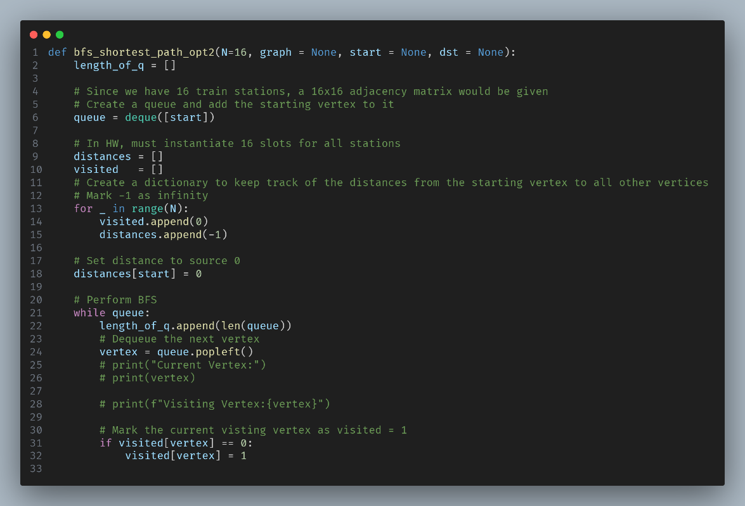
Example: BFS in Graph Traversal (Bad for Parrallelism)

Slide 10
Basic Components of Digital system Combinational
Mux
Decoder, Encoder, Priority Encoder, Decoder
Arithmetic operator, +, - , Sqrt() …
Adder-tree
MAC-tree
Complex high-level Combinational block(High level programming in always@* )

Slide 11
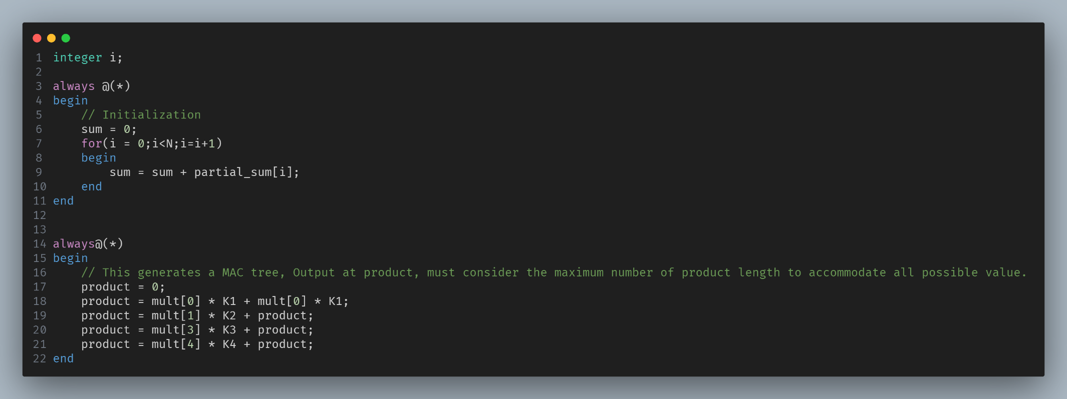
Adder Tree and MAC Tree Verilog Syntax

Slide 12
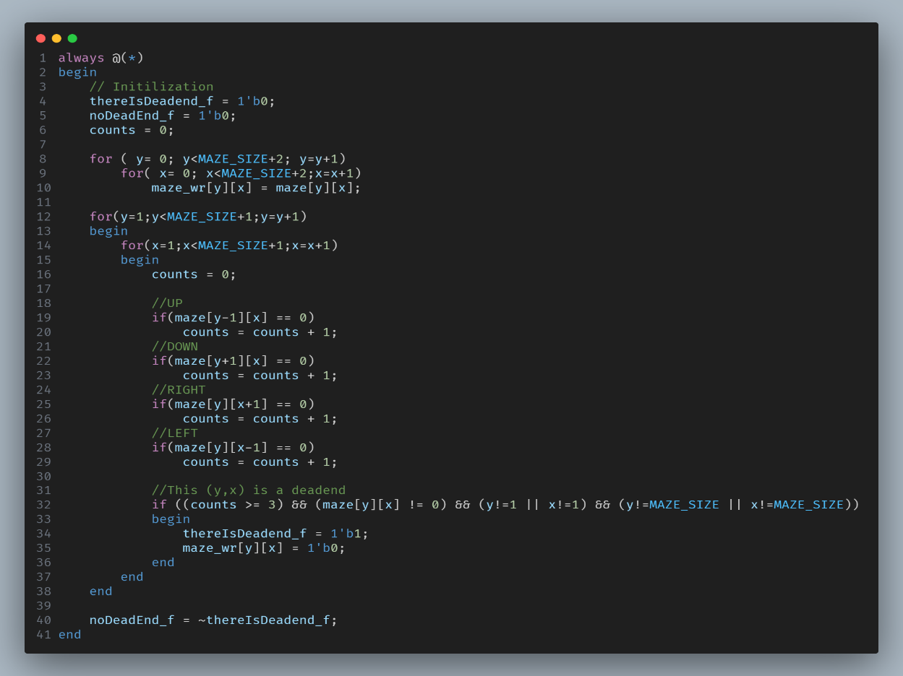
Even more complex example A part of dead-end filling algorithm

Slide 13
Basic Components of digital system Sequential
Registers
Counters
Main Controls
Sub Controls
Memory (SRAM , DRAM)

Slide 14
Basic Execution blocks of digital system
ALU(CPU functional block)
Register File(Storage units for processor)
Stack(Used Extensively in Back-tracking problem and DFS)
Queue(BFS , Operating system, Architectural Pipeline, CDC fundamentals)
Priority Queue(Fundamental of Dijkstra algorithm)
Cache(CPU Functional block)

Slide 15
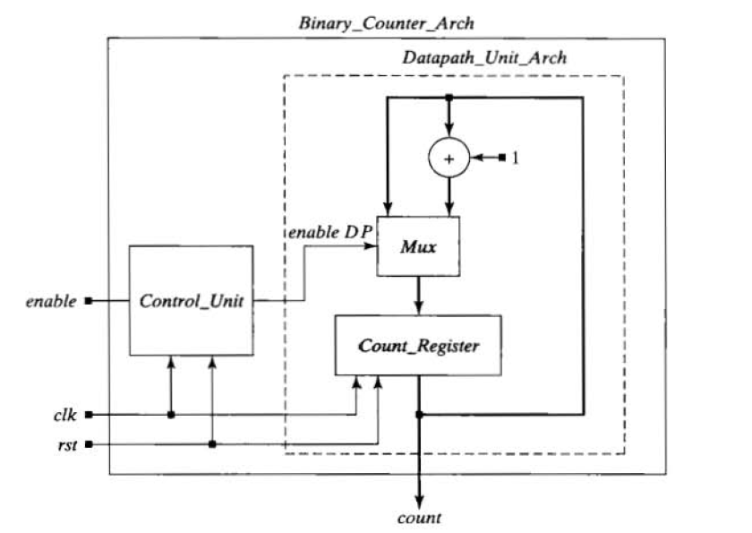
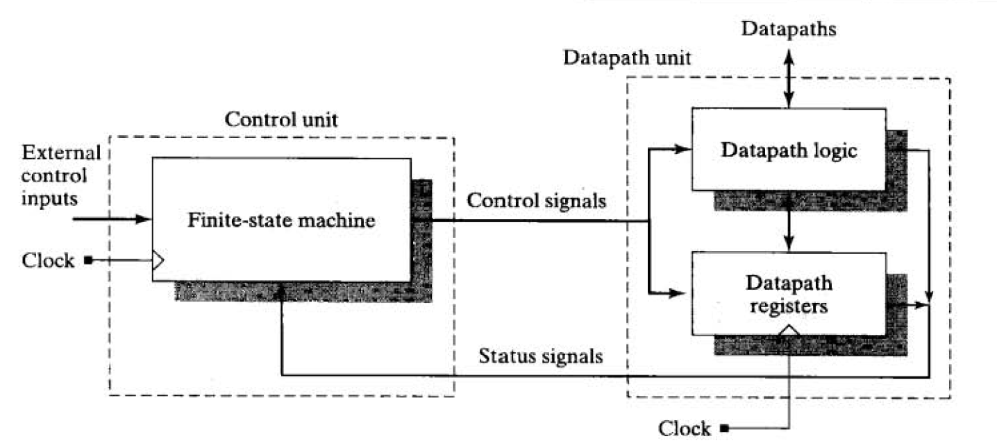
Partition of digital system Datapath and Controlpath partitioning

Slide 16
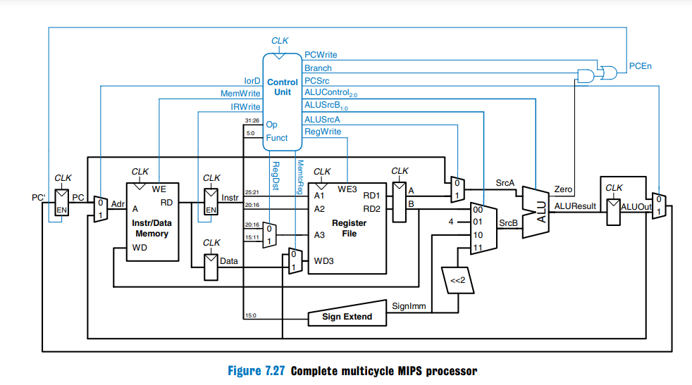
MIPS CPU

Slide 17
Basic architecture types
Single cycle machine
Multi-Cycle Machine
Pipelined architecture
Systolic array architecture

Slide 18
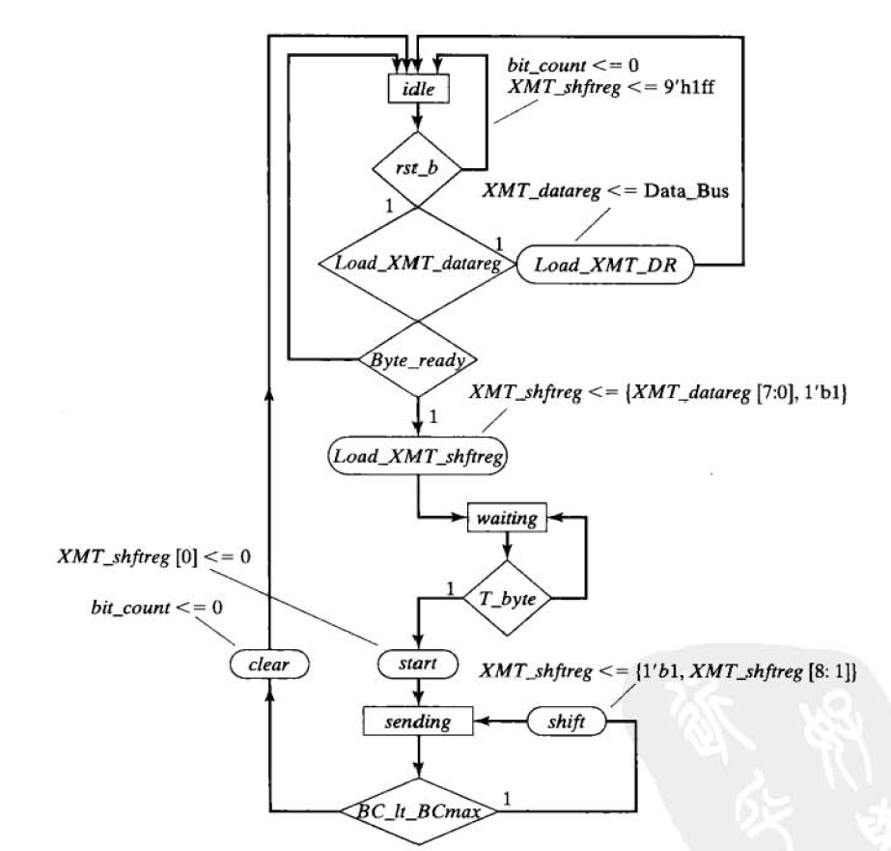
Algorithmic State machine with datapath(ASMD)

Slide 19
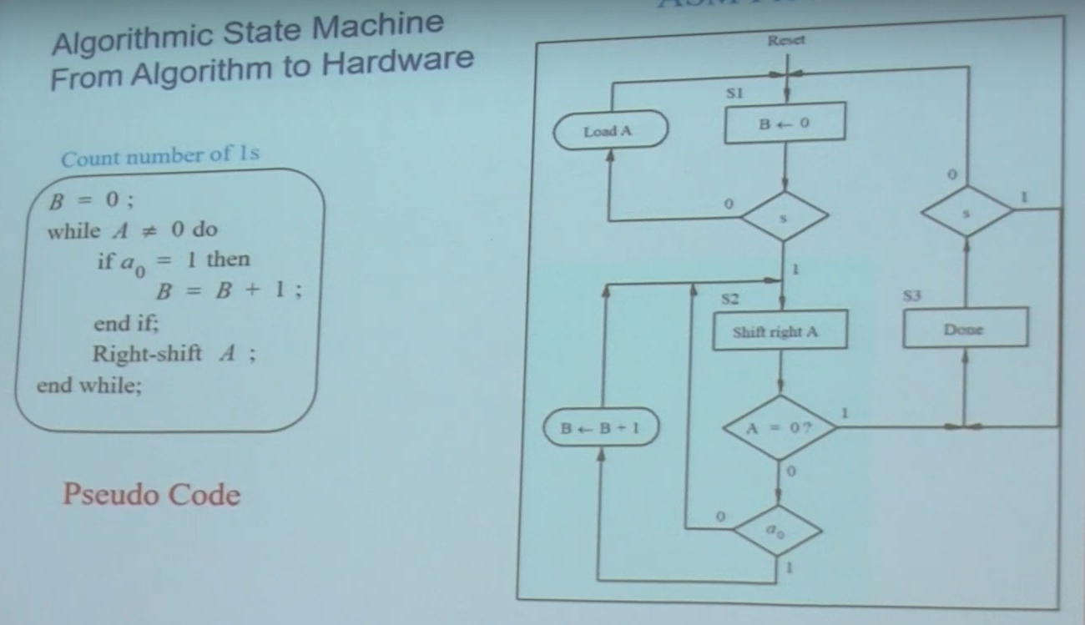
Sequential binary counter example

Slide 20
Mapping from algorithm to Architecture
All the techniques you have learnt in VLSI DSP
Folding
Unfolding
Dependence graph for systolic array mapping
Pipelining etc….
Tips lies in the description of your WORKABLE algorithm

Slide 21
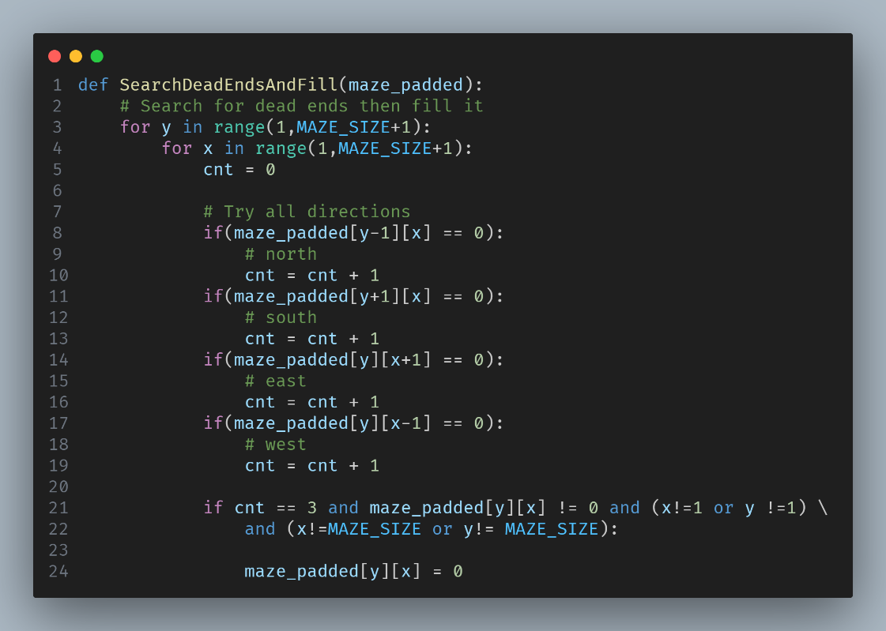
Another Example Dead-end filling algorithm

Slide 22
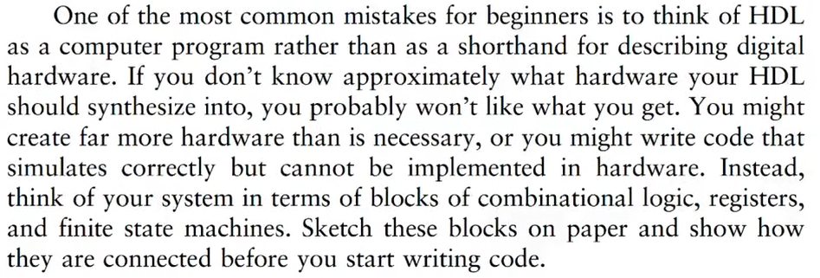
Advice when implementing HW in HDL
CH4.10 Digital Design and Computer Architecture 2nd edition, David Harris, Sarah Harris, p225

Slide 23
其他大推學習資源(如果有時間)
NYCU 數位電路與系統 2023 by 張添烜
Digital design and Computer architecture by Onur Mutlu

Slide 24
References
CH7 & CH9 Michael D. Ciletti - Advanced Digital Design With the Verilog HDL (2nd Ed) [OCR]-Pearson
CH1 Digital Design and Computer Architecture 2nd edition, David Harris, Sarah Harris
Lecture notes, MIT 6.375 complex digital systems
Lecture notes, MIT 6.004, Computation structures| Spring 2017 | Undergraduate
Lecture 1: Introduction and Basics, Digital Design and Computer Architecture Spring 2022, Onur Mutlu
Lecture 7: Hardware Description Languages and Verilog, Digital Design and Computer Architecture Spring 2022, Onur Mutlu
NYCU 數位電路與系統 2023講義 , 張添烜

